Slide 1

By : Mr. Omkar Tanaji Gurav

Slide 2
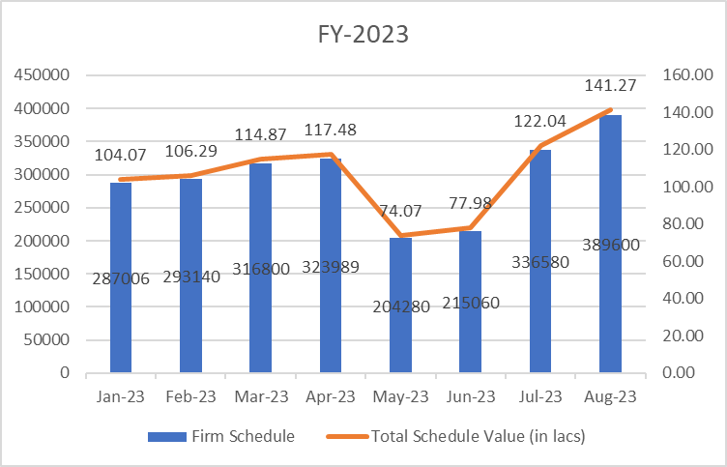
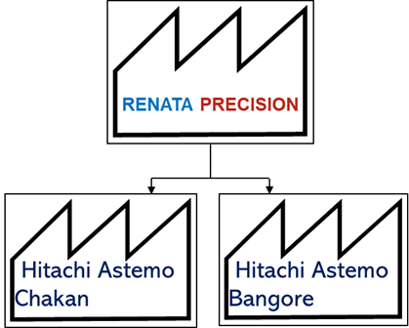
Value Stream Map M -1 :
Customer Selection : Based On Customer’s Demands And Sells We Select Our Customer HITACHI ASTEMO FIE PVT.LTD.
Part Name : Base Unit B95A ( 3485-B95A-001) .
FY 2023 Monthly Shedule From January to August :

Slide 3
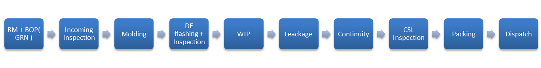
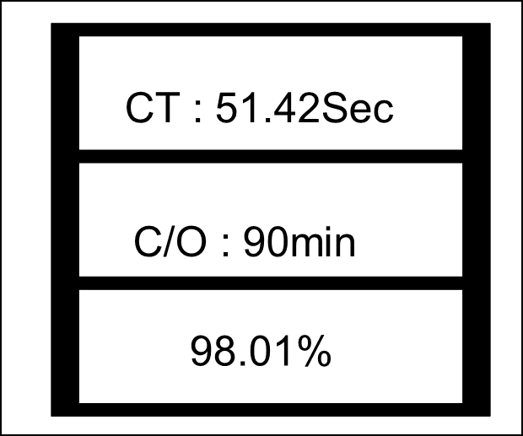
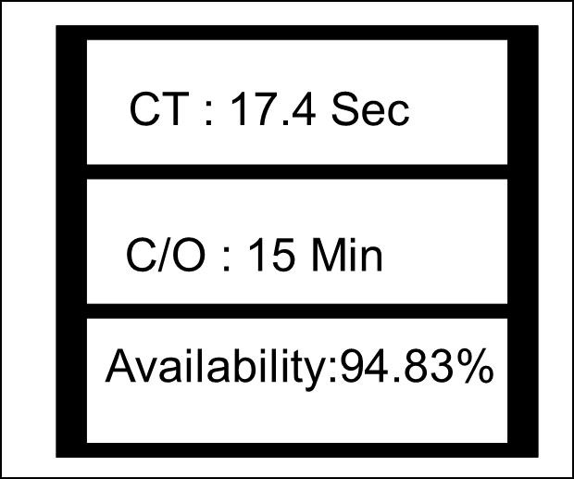
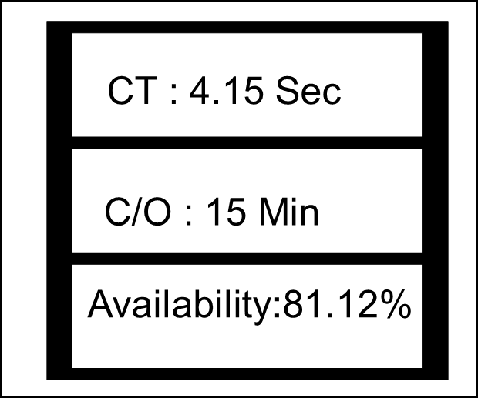
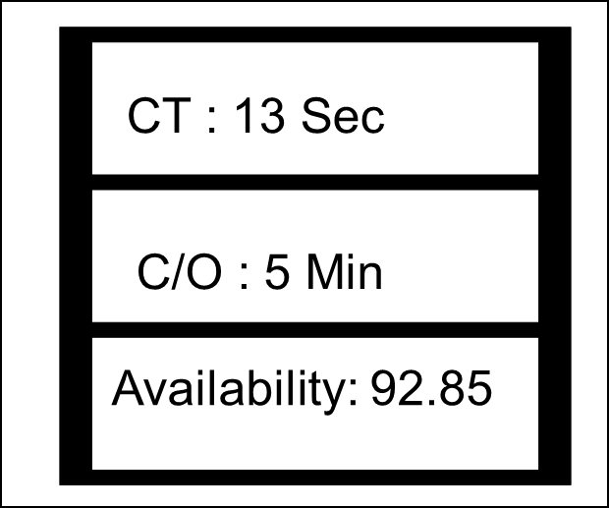
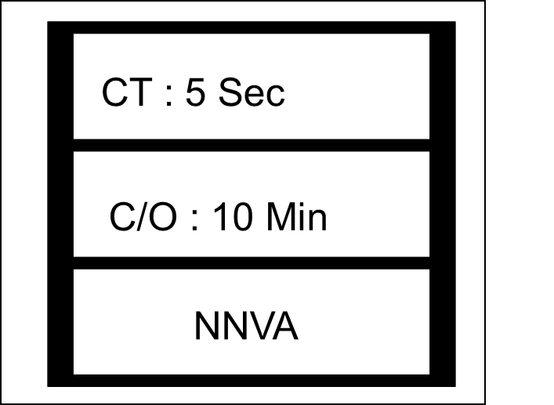
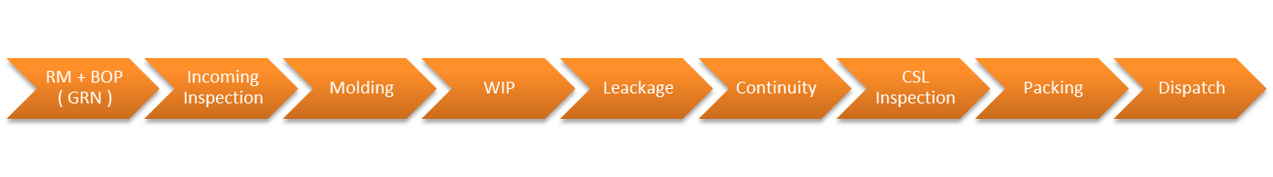
Value Stream Map M -2 :
Actual Process Flow Chart :
Standard Process Flow Chart :

Slide 4
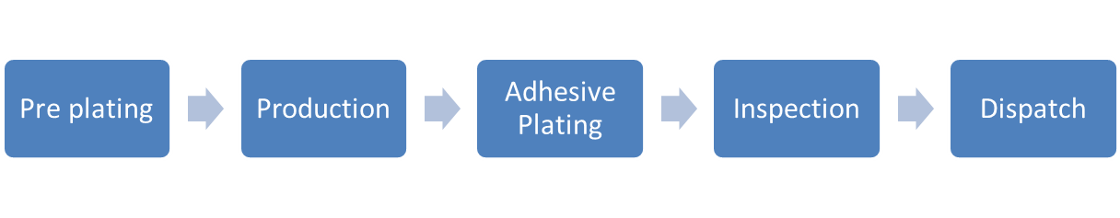
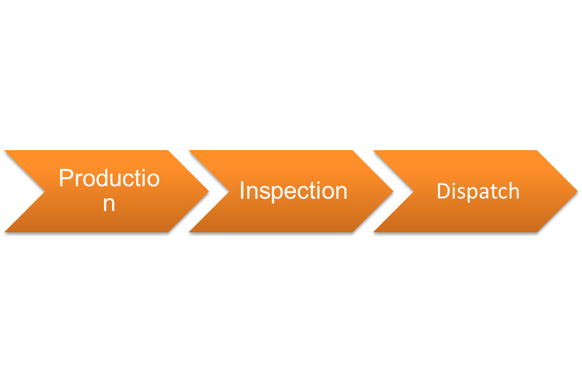
Stamping Actual Process Flow Chart :
Part Name : Adhesive Terminal
Stamping Standard Process Flow Chart :

Slide 5
VSM M-3 : Material Flow
Material flow Is In Three Ways :
From Supplier End To Renata : According to our requirement we generates the PO for Raw Material Purchase , From Our Supplier for raw material POM-C / DURACON M9044 the transit time is around 3-4 hrs and 2 trucks per week ; Approximate Quantity Ordered Is 500-600KGs .
From Renata To Customer : From Renata to customer we delivered our material to Hitachi Astemo Chakan by Local vehicle and To Banglore Hitachi Atemo Plant we deliver by two ways PTL at KBX logistics and by FTL .
For Internal Movement : For Internal Movement As In From Unit 2 to Deflashing and again deflashing to Unit 2 & 4FG to 6FG material supply.

Slide 6
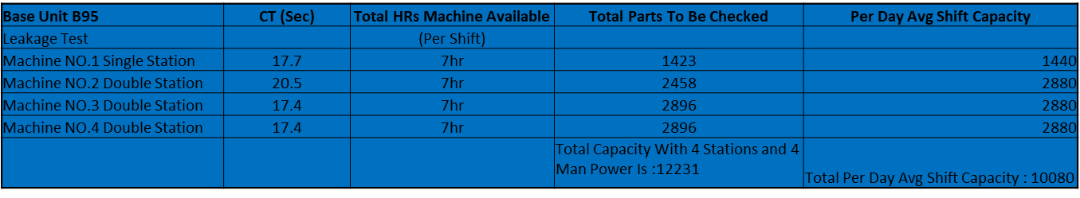
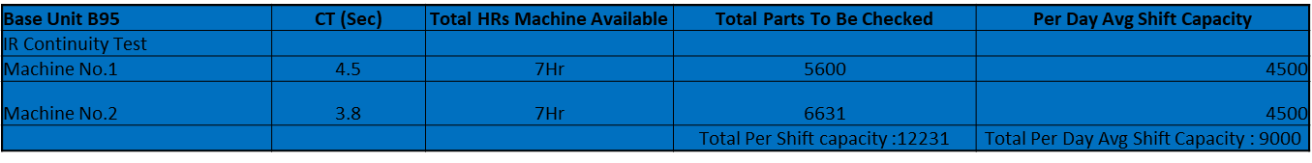
For Material Flow VSM Measures :
Production CT And Per Shift Capacity Calculation :
Assembly Leakage Test M.C :
IR Continuity Test M.C :

Slide 7
Rejection Rate Of B95A At Assembly End:
Rejection Rate Of B95A In Internal Assembly Is 0.86-1 %
Rejection Rate Of B95A At Assembly (External Rejected Quantity Rechecking Data )
Assembly External Rejection Rate | Total Rejection At Supplier End | In Rechecking Total Ok Quantity | Rejected Quantity | Rejection Percent | Total Quantity Of Month | Final Rejection Per % wrt Total Q
Jun-23 | 12330 | 11054 | 1276 | 10.34% | 277620 | 0.459
Jul-23 | 9039 | 891 | 948 | 10.48% | 290980 | 0.325
AVG.Rejection Quantity |  |  |  | 10.41% |  | 0.39%

Slide 8



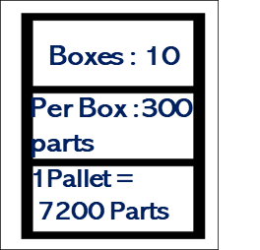
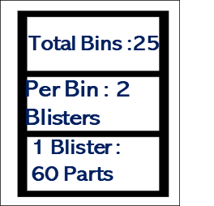


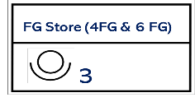
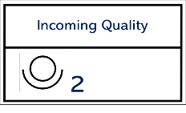
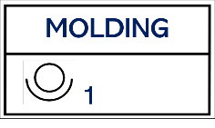
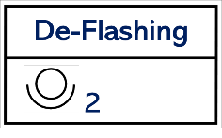
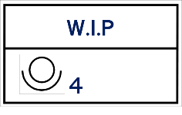
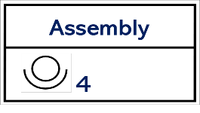




VSM Map For Material Movement :
2 Vehicles/Week
500-900KGs
400KGs
2950
2950
2939
2910
This VSM Map Is For 1Mold/1Machine/1Day Production

Slide 9
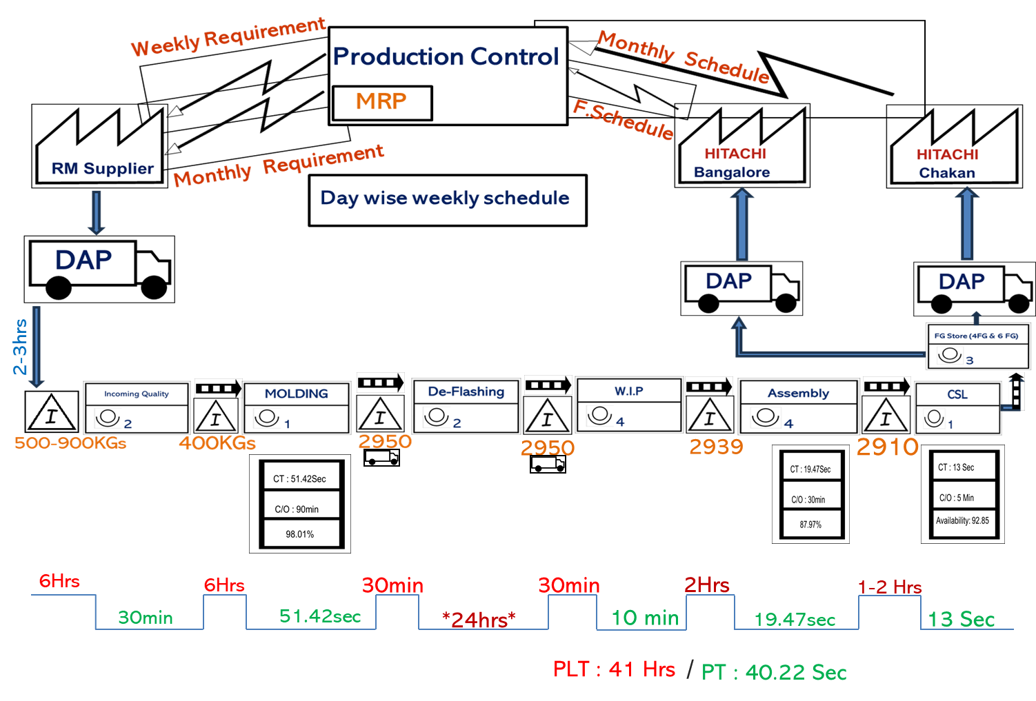
VSM Map Of Base Unit B95A :

Slide 10
Base Unit B-95A | NVAs | Scope Of Improvement
Production | Operator's Motion for Material Movement | Dedicated Person For Material Movement
 | Change Over Time IS >60 Min | It Has To In Between 15-30 Min
 | Storage Of 8/9 Bins At Machine Station | To Avoide Safety Incident The Bins Should Moved At DOC Area
 | Bin Packaging Without Confirming Quality | Not Ok Parts Passes Into Pipeline
 | Not Following Proper Poka-Yoke Which Has been Assigned | Use Of HOLD Stickers And Barrier Implementation Is Useful to avoid Material Mixing
 |  | Go No-go gauge Test at Machine
Assembly | Holding Material In 4RM For Longer Duration | Material Flow Should be Ontime
 | Rechecking All NOT OK parts which came from Deflashing
 | DE flashing & 200% Inspection done
 | Internal Material Movement Of Bins | Dedicated Person For Material Movement
 | Marking On Parts At Every Stage
 | Report Filling Hourly & Root Card Filling
 | Damage of parts due to bulk packaging
 | Leakage & Continuity M/C under breakdowns several times
 | Material Movement From 1RM to 4RM on small trolly

